Slide 1
Graph Theory Applications of graph in data structures using c sharp
Section 12
Group B
Mohamed Al Sayed Mohamed Hassan
Mohamed Gamal Mahmoud Mohamed sarhan
محمد السيد محمد حسن حسن
محمد جمال محمود محمد سرحان
ALL SOURCE CODES USED IN THIS SLIDE ARE WRITTEN BY US, THE WHOSLE SLIDE IS WRITTEN BY US NOTHING IS STOLEN FORM THE INTERNET

Slide 2
Contents
Introduction
What is a graph
Algorithm of the graph
Class pattern design and implementation
Designing the edge
Designing the vertex
Designing the graph
Create an API for the graph

Slide 3
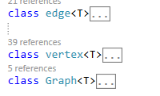
Introduction
In this preview ,I will be explaining the graph , It’s algorithm , how to create it in an object-oriented form.
I will start building the graph from the bottom to the top , by creating a class for the edge , a class for the vertex that holds a list of edges , and a class for the graph that holds a list of vertices

Slide 4
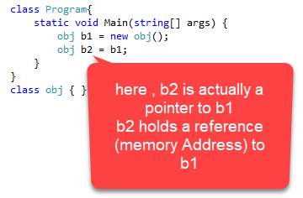
The Language I will be using in this preview is C#, Why c#?
C# is a great object oriented programming Language
C# supports LINQ which is a programming model that is natively implemented in
the .NET framework , which enables us to perform queries over the vertices and edges of
our graph incredibly fast.
C# support pointers and references, however the programmer is abstracted from it, this property will help us a lot during the implementation of edges .
C# do support real pointers in unsafe mode, but we don’t need to use it
or use passing byref as this what the framework will actually do for us

Slide 5
The Graph
A graph is a set of vertices connected to each others by a set of edges
An Undirected graph is a graph where all edges are bidirectional , means that the edge connecting a to b is the same edge from b to a, you can go from a to b and back from a to b
A directed graph is a graph where edges has only one direction , means that the edge from a to b is not the same as the edge from b to a, having an edge from a to b means that you can only go from a to b , but you can’t go back

Slide 6
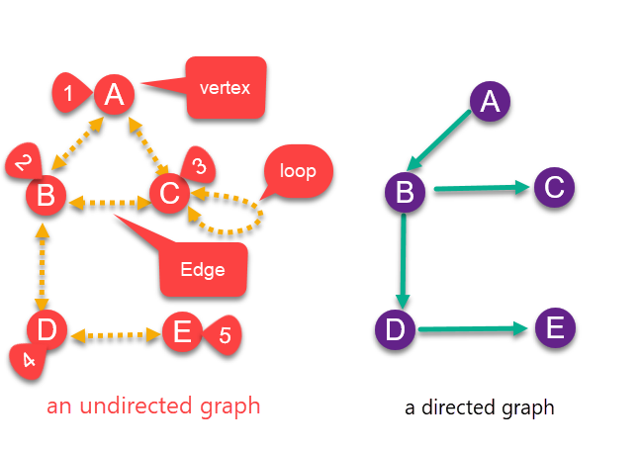
A vertex : Each node of the graph is represented as a vertex, therefore {A,B,C,D,E} are vertices. Each vertex can have a name or an index.
An Edge: is a line between two vertices, therefore {AB,AC,BC,BD,DE} are edges. Each edge can have a weight or a value assigned to it
In graph 1 they are undirected Edges, means that AB is the same as BA
In graph 2 they are directed ,means that you can only go from A to B
Some directed graphs may have an edge from A to B
And another edge from B to A , but with different values , for certain problems and Algorithms
(e.g. the cost of going to a certain city or vertex is less that
The cost of returning
A loop: is an edge that begins and ends with the same vertex

Slide 7
Graph Algorithm
To construct a graph it must have :
1. A set of vertices, with each one can have a name or an index
2. A set of edges that connect these vertices together , a source vertex to a destination vertex ,
these edges can have weights assigned to them
3.A method to add more vertices
4.A method to connect two vertices together through an edge
5.A method to remove certain vertices along with all it’s connected edges
6.A method to remove an edge
7.A method to move across edges and vertices of the graph (a Path)
8.A method to display information about vertices and edges as well as changing their values

Slide 8
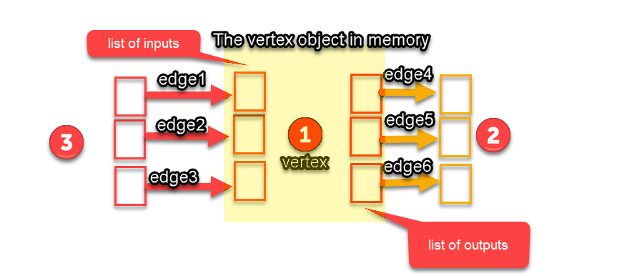
Vertex class representation

Slide 9
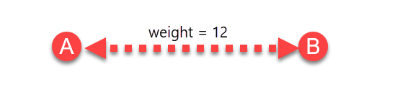
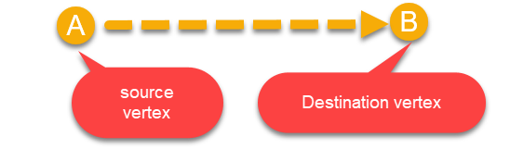
The Edge
An Edge is an object that has these attributes :
A source Vertex
A destination Vertex
A weight or value
In case of undirected graphs , Edges will be bidirectional , meaning that for each edge going
from a to b there will be an edge going from b to a

Slide 10
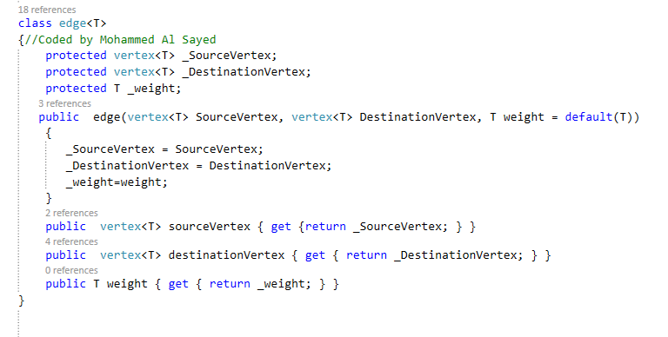
C# Implementation of the edge

Slide 11
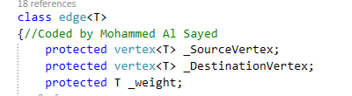
First of all , we define two vertices
The source vertex and the destination vertex
Then we define a generic-type variable that will hold the weight/value of that Edge
We assign them as protected members to be able to extend this class later without having to expose
our variable (encapsulation)

Slide 12
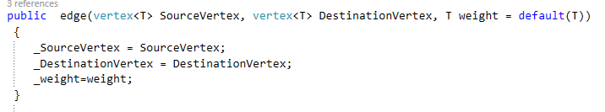
Then we define the constructor , the only thing that the constructor does is taking the values of source index , destination index and weight , then assign it to the previous variables.
We use weight =default(T) to assign the weight an optional value of the default value of the type T (optional parameter)

Slide 13
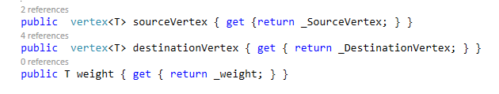
Finally we Create three properties to expose our inner data members
A property to get source vertex
A property to get destination index
And a property to get the edge weight

Slide 14
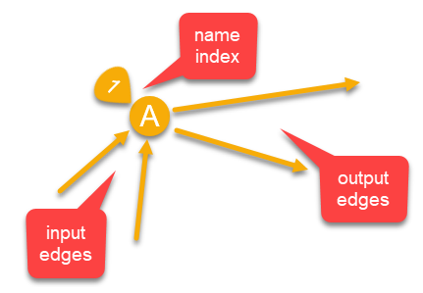
The vertex
An vertex is an object that has these attributes :
A set of edges that are going out from this vertex (out degree)
A set of edges that are going into this vertex (in degree)
A string that represent this vertex name or value
An index that represent this vertex order in the graph
A simple constructor for values assignment
A method to add an edge
A method to remove an edge
A method that returns an edge object
Methods that exposes the vertex properties
such as the name , value , index
inputs and outputs of that vertex

Slide 15
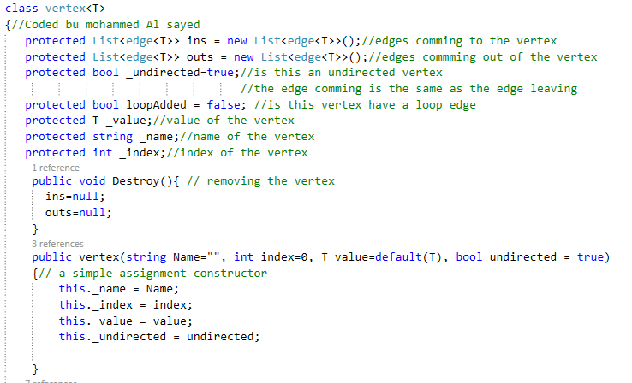
C# implementation of THE vertex

Slide 16
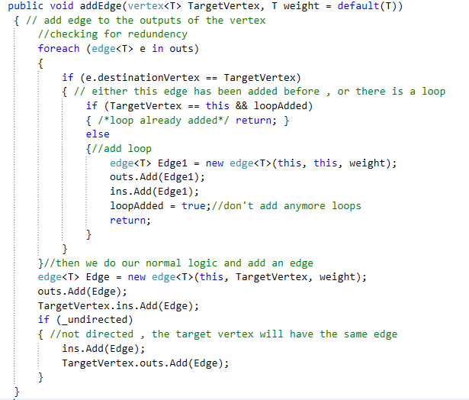

Slide 17
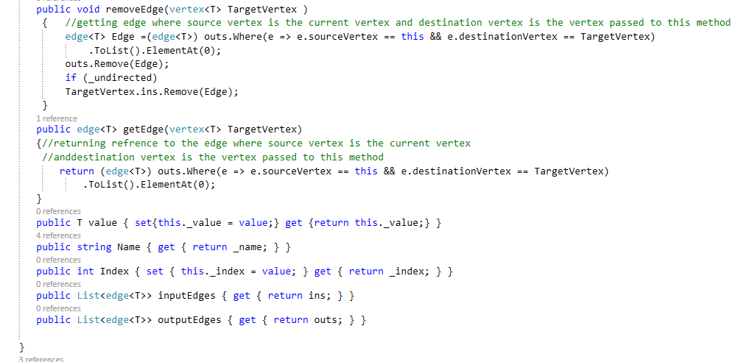

Slide 18
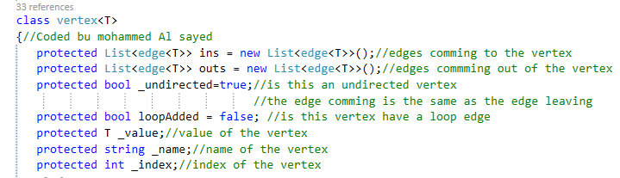
Explanation
1.Here I’m defining two lists of edges , a list that holds edges going to the vertex And a list that holds edges going out of that vertex
2.Then I define a Boolean variable that decides whether the vertex is directed or undirected
In case of undirected vertices, the inputs and outputs lists will hold reference to the same edge object
In case of directed vertices, each list will hold different objects
3.Then I define another Boolean variable that decides whether this vertex is looped or not, we also use this variable to check for redundancy (two different objects with the same attributers)
4.Finally I define three variable , the first hold the value of the loop , another one for the name , and the third for the index

Slide 19
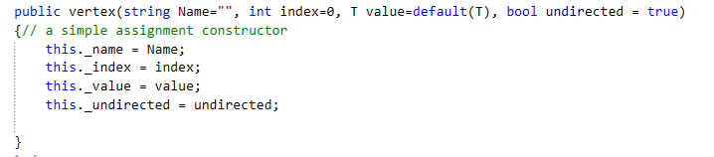
Here I’m defining the constructor , It’s a simple constructor that assign each variable to it’s value
Notice that all the parameters are optional , this provides great flexibility to our vertex because the user might want to have a vertex that only represent a node on the graph and has no value or name
He might want to name the vertex or give it a value or both ..

Slide 20

Here we are defining a simple method to destroy this vertex ,buy assigning all the edges pointing to it and all the edges going out from it , an since an edge is actually a pointer, by doing this we are removing all pointers to this object , leaving it for the garbage collector to remove it from memory

Slide 21
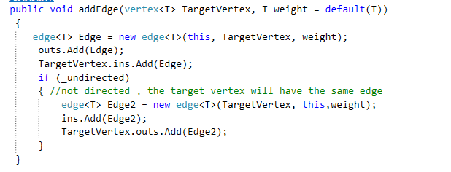
This method adds an edge to the list of output edges of the current vertex , It creates a new edge object , and assign the current vertex as source vertex , and the target vertex as destination
It also assign weight to this object .
Finally we push this object to the list of outputs the current vertex and the list of outputs of the targeted vertex .
In case undirected graph (meaning that the edges are bidirectional) we do the same thing but vice versa

Slide 22
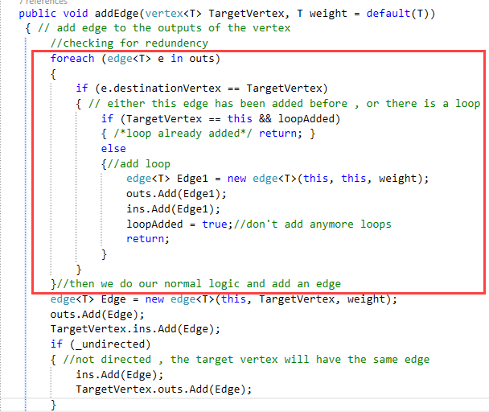
However , there is a serious problem in the logic above, What if the user forgot and added the same edge two times, this will cause our list of objects to reference two different objects with exactly the same attributes , which will not only increase memory usage, but will also miss up with our LINQ queries and our logic
That’s why we add the following chunk of code

Slide 23
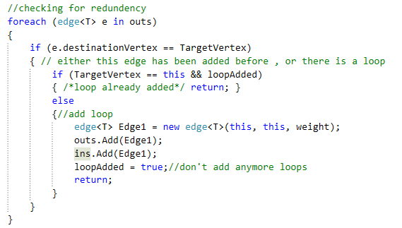
What the following code does is that it iterates over all the edges going out of the current vertex, if it found an edge that has the same destination vertex as the target vertex passed to this method, then there are two options 1. Either this edge is redundant (already exists )
2. or the user is adding a loop, so we check the Boolean loop added which decides if this vertex has a loop edge or not , if it doesn’t , then add a looped edge and assign loopAdded = true , so we don’t add any other loops

Slide 24
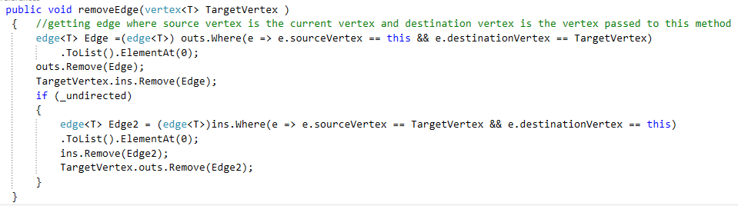
The following method removes an edge that goes from the current vertex to the Target vertex ,
It queries the output list of our vertex , then removes this edge from the outputs of our vertex and the inputs of the target vertex
If our vertex is undirected, then it does the same thing vice versa

Slide 25
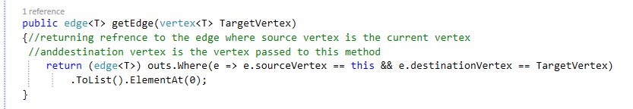
The following method quires the vertex list of outputs , then returns and edge object whose source vertex is the current vertex and destination vertex is the Target vertex.
Through this object you can access other public member of that edge such as it’s weight

Slide 26
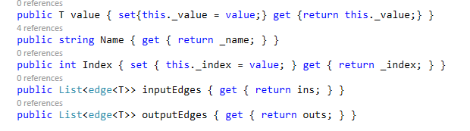
Finally we have the following properties,
1.The first gets and sets the value of the vertex
2.The second gets the name of the vertex
3.The third gets and sets the index (so we can update it in case of vertices removed)
4.The forth returns the input edges
And the last returns the output edges

Slide 27
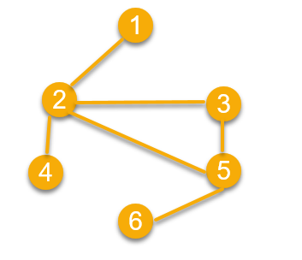
THE Graph
The Graph is an object that has the following attributes :
1.A list of vertices , these vertices will contain two lists of edges (input , output) connecting them
together to form the graph
2.A method to add a vertex
3.A method to add an edge between two vertices
4.A method to remove a vertex
5.A method to remove and edge between two vertices
6.A method to iterate over the graph vertices
7.A method to return an object of a certain vertex to show it’s value or change it

Slide 28
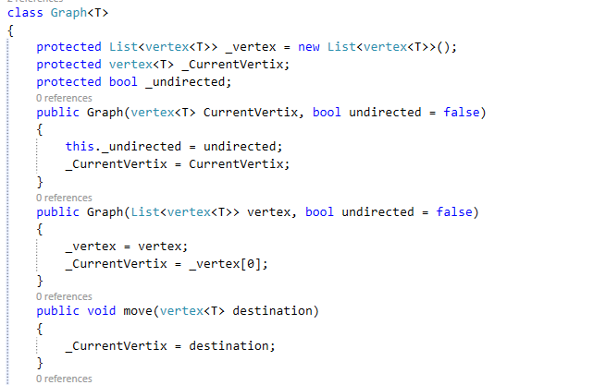
C# implementation of the graph

Slide 29
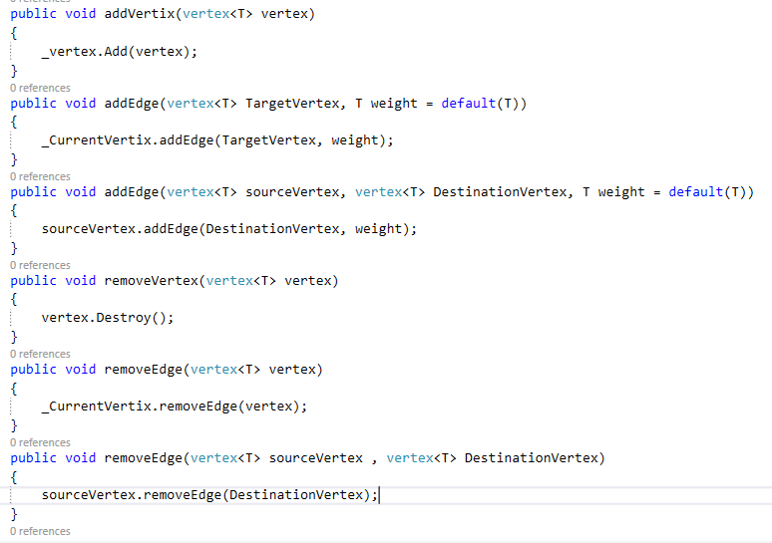

Slide 30
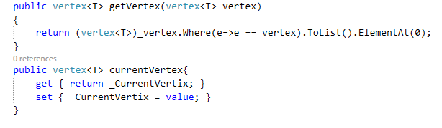

Slide 31
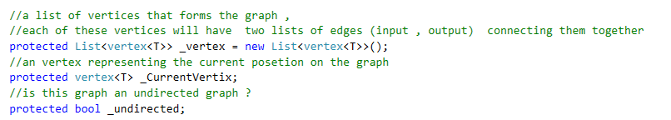
explanation
1.Here we are defining a list of vertices that forms the graph , each of these vertices will have two lists of edges (input , output) connecting them together as mentioned before
2.We have a vertex called current vertex, which will represent an iterator that holds the current position as we move along the graph
3.Finally we define a Boolean called _undirected which decides whether this graph is undirected or not This Boolean will be passed to vertices inside the graph

Slide 32
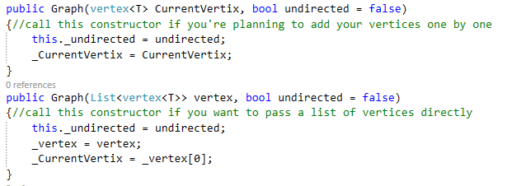
Here we have two overloaded constructors
The first take a vertex representing the beginning of the graph and a Boolean representing whether this graph is directed or not , the user can use this constructor if he is planning to add vertices to the graph one by one
The second constructor is the same as the first but it takes a list of vertices , and assign the first vertex as the current vertex

Slide 33


This method simply move to a vertex by assigning the value of this vertex to the Current vertex
This method adds a vertex to the list of vertices forming the graph

Slide 34


This methods connects a vertex to the current vertex our graph is stopped at , through an edge object ,it also passes a weight to that edge.
This method is the same as the first one , however it connects any two vertices on the graph,
even if neither of them is the current vertex we are stopping at

Slide 35


This method removes a vertex from the graph then destroys it
This method removes an edge connecting the current vertex with another vertex

Slide 36



This method removes an edge connecting two vertices on the graph , use this when you want to remove an edge between two vertices without having to move to them
This method returns an object of vertex from the graph matching the passed object
Gets or sets the current vertex

Slide 37
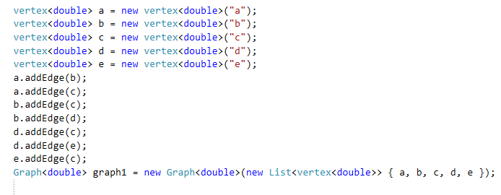
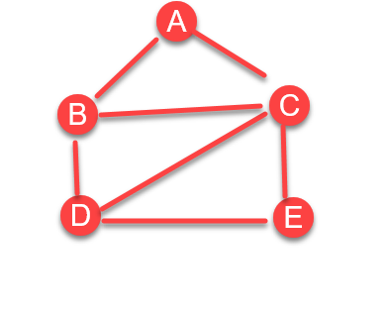
Using our graph
I will construct the following graph

Slide 38
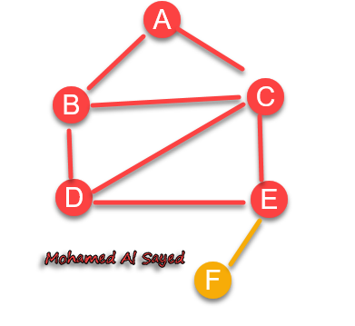


Now I will add another vertex to e called f

Slide 39
Enhancing our graph
Now the graph is perfectly implemented to be used as a programming interface, however we might want to use this graph in a non-programmer way , for example , we might create an executable that takes a list of vertices as a string “a,b,c,d” and a list of edges “ab,ac,ad,c,d” to create a graph
I will create another constructor that does this
It will take :
1.A string representing vertices “a,b,c,d”
2.A string representing edges “ab,ac,ad,c,d”
3.A string representing value “1,2,3.3,13”

Slide 40
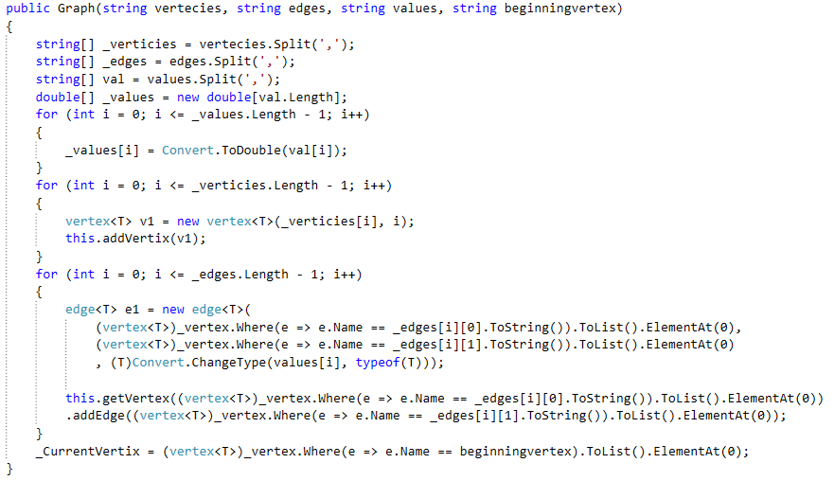

Slide 41
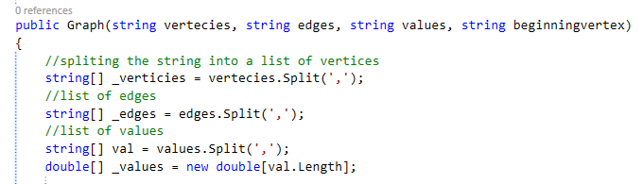
Algorithm
1.The user will enter the parameters like this :
New Graph(“a,b,c,d”,”ab,cd,ac”,”1,2,3”,”a”);
2.So we split the first parameter , vertices for the character ‘,’ to obtain an array of vertices
3.Then we split the second parameter to get an array of edges , and the third parameter to get an array of values

Slide 42
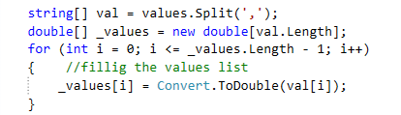
1.Here, we split the values string into an array of values , then we create another array of double equal in size to the first array
2.Then we iterate over all the members of the values array , convert each one to Double , then assigning it to it’s corresponding position in the double array

Slide 43
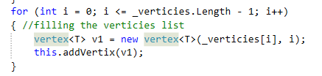
1.Here , we iterate over the array of vertices(strings) we crated
2.For each member of this array , we create a corresponding vertex object
holding it’s name and index , then we push it to the graph vertices list

Slide 44

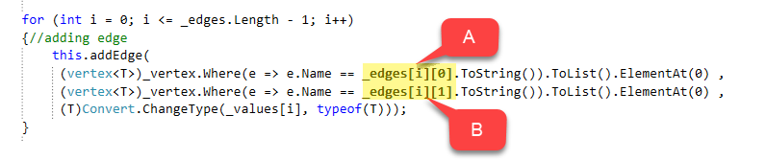
The next chunk of code might seem complex, but actually it’s very simple
1.We iterate over the edges array
2.We get the vertices that represent this edge by splitting this edge “AB” into two chars “A” and “B” , the first represent source vertex “A” and the second represent the destination vertex “B” .
1.We query the current vertices for the source and destination vertices
2.Then we add their reference to a new edge
3.Then we add this edge to the graph
the method addEdge(); inside the vertex object will do the rest of work as explained before

Slide 45

Finally we assign the current vertex to the beginning vertex , by querying our vertices , looking for a vertex that matches it’s name
We add the method getVertexByName(); ,that takes in the name of the vertex ,
then return a reference to this vertex object

Slide 46
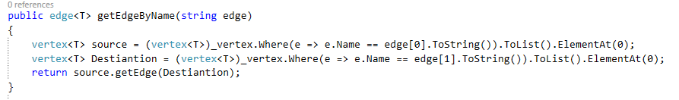
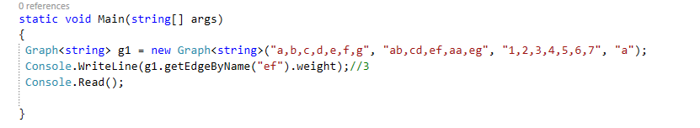
We add the method getEdgeByName(); that takes in the edge name , and returns a reference to an edge object

Slide 47
The End

